Slide 1

NVIDIA AICity Challenge 2017 Track 1 Using RDFCN model
Iowa State University

Slide 2

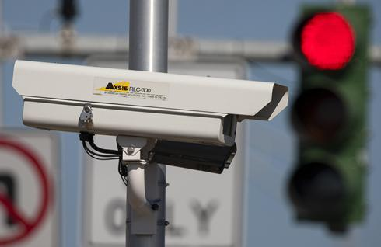
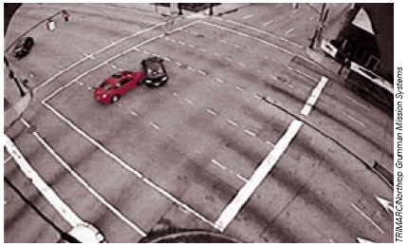
Introduction
Transportation can benefit from data captured by surveillance cameras
Challenge Task: Detect and classify object from intersection cameras
14 classes:
[Car, SUV, SmallTruck, MediumTruck, LargeTruck, Pedestrian, Bus, Van,GroupOfPeople, Bicycle, Motorcycle,
TrafficSignal-Green, TrafficSignal-Yellow, TrafficSignal-Red]

Slide 3
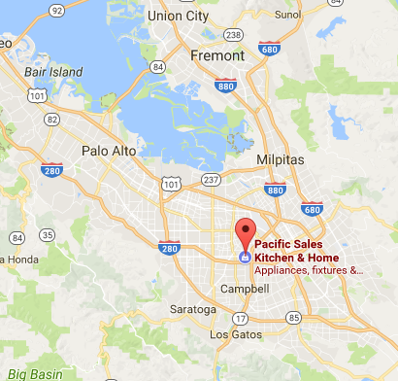
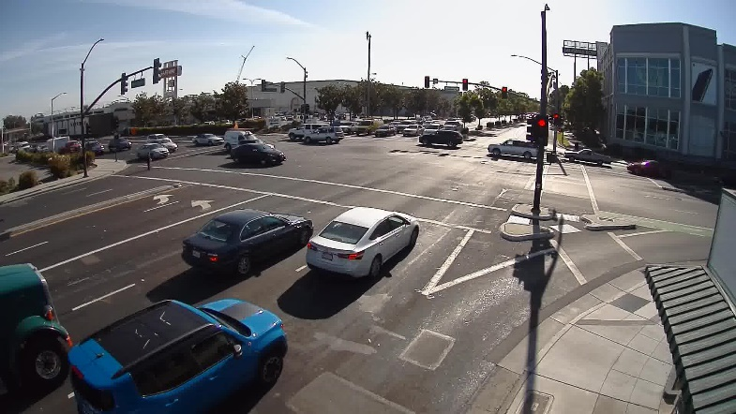
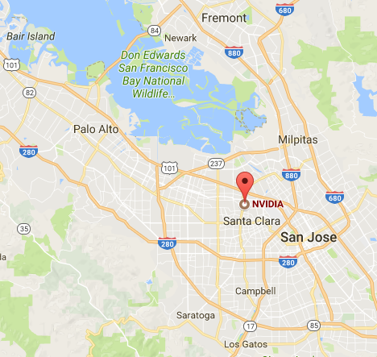
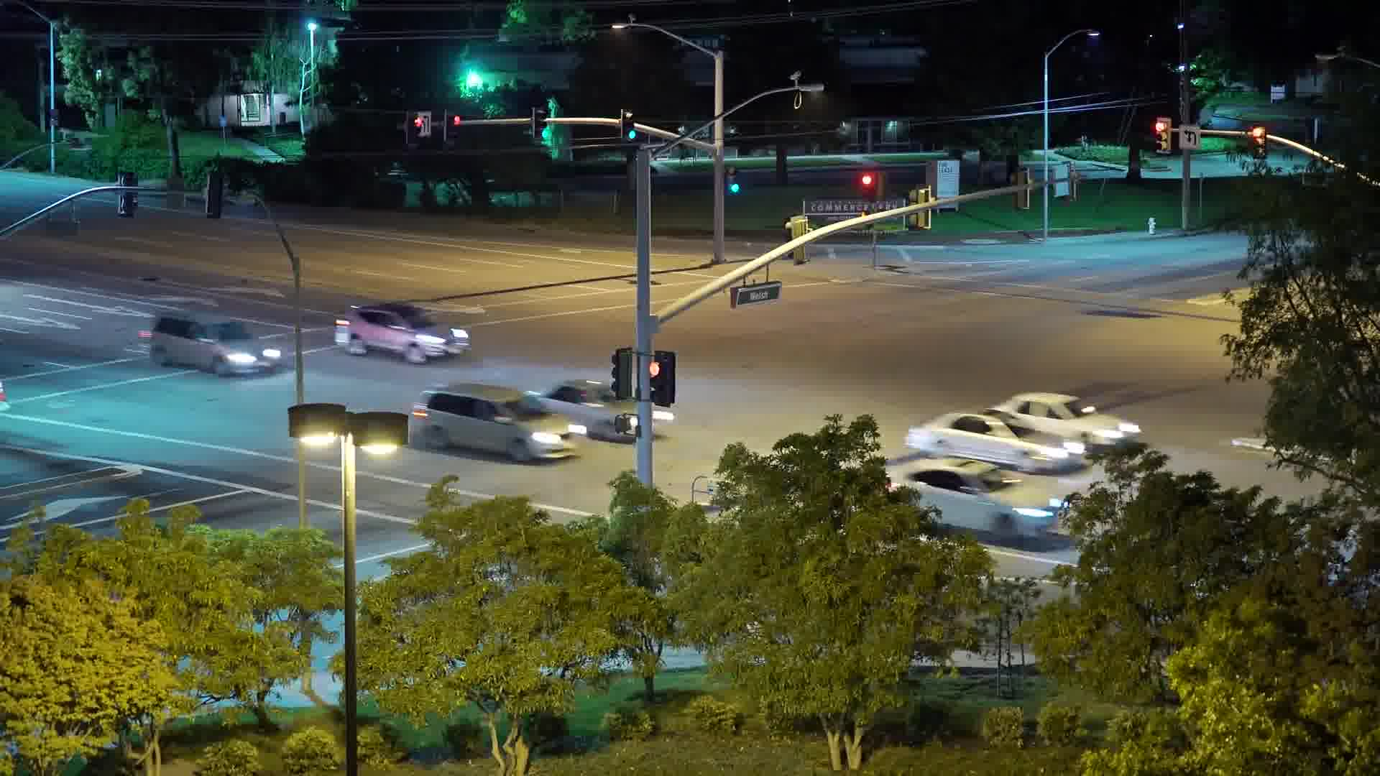
Data Source
Video data available for this challenge has been recorded by cameras aimed at intersections in urban areas:
Silicon Valley Intersection Data - 70 hours, 1080p, 30 fps
Virginia Beach Intersection Data - 50 hours, 720x480, 30 fps
Lincoln, Nebraska Data - 10 hours, 720x480, 30 fps
~ 80K images
stevens_cr_winchester
walsh_santomas

Slide 4
Methodology - RDFCN
RDFCN is initially described in:
J. Dai, H. Qi, Y. Xiong, Y. Li, G. Zhang, H. Hu, and Y. Wei. Deformable convolutional networks. arXiv preprint arXiv:1703.06211, 2017.
RDFCN – Region-based Deformable Fully Convolutional Networks
R-FCN (Region-based Fully Convolutional Networks)
faster inference speed
Deformable ConvNets (Deformable Convolutional Networks)
higher detection accuracy

Slide 5
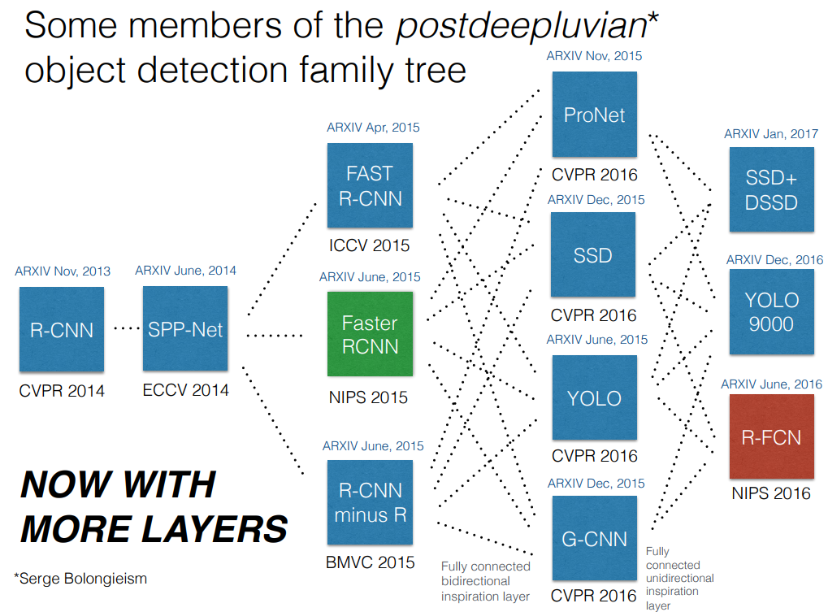
Methodology - RFCN

Slide 6
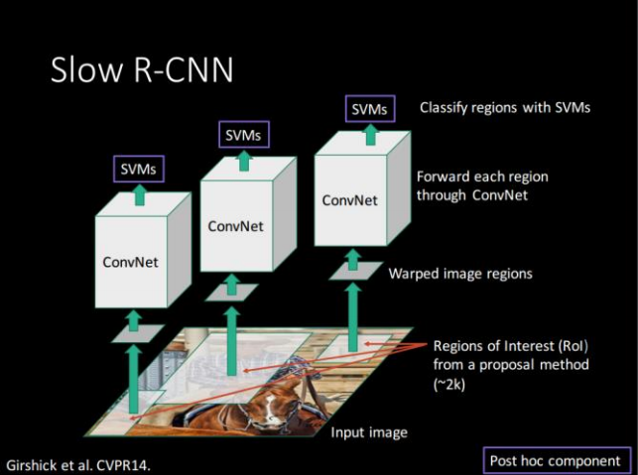
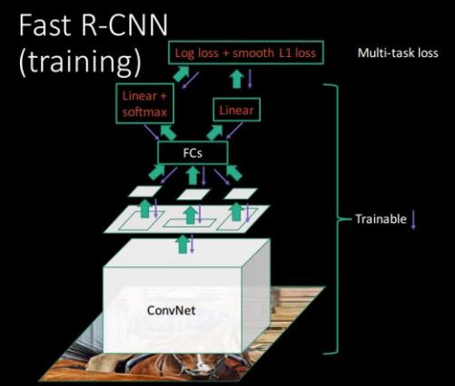
Methodology – R-CNN to Fast R-CNN

Slide 7
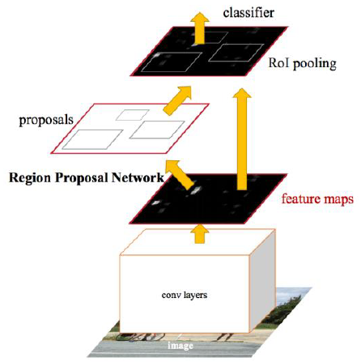
Methodology – Fast R-CNN to Faster R-CNN
Faster R-CNN

Slide 8
Methodology – Faster R-CNN to R-FCN
Faster R-CNN
R-FCN
Final Result
Location Sensitive Maps

Slide 9
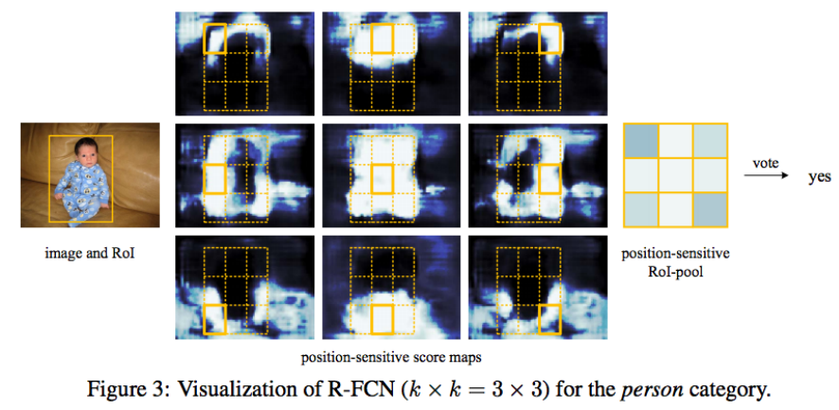
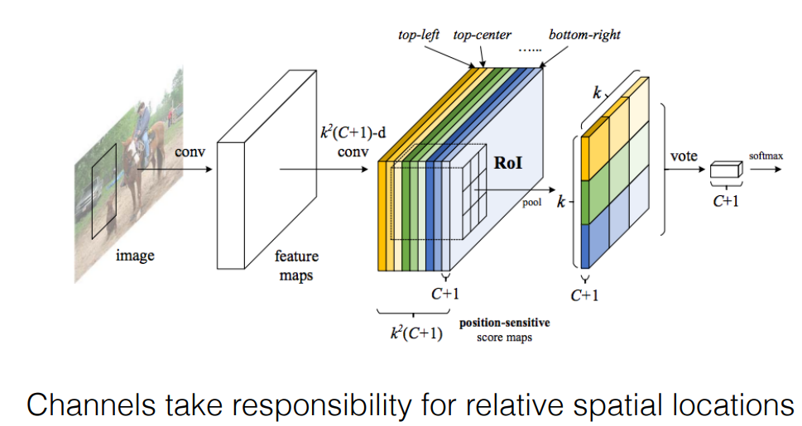
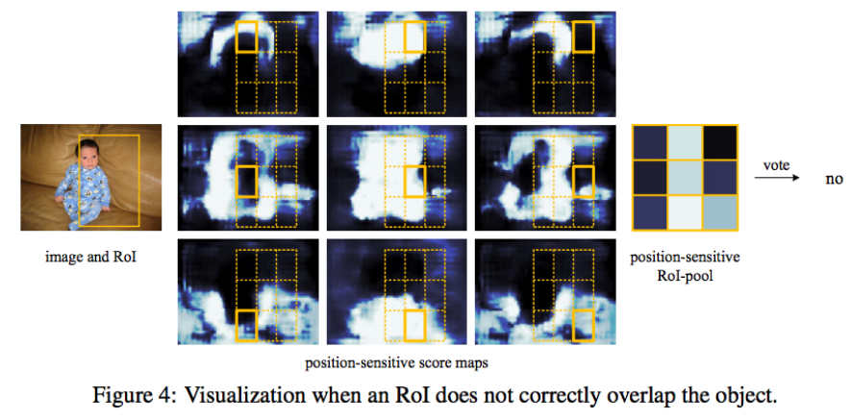
Methodology – Faster R-CNN to R-FCN
Location Sensitive Maps

Slide 10
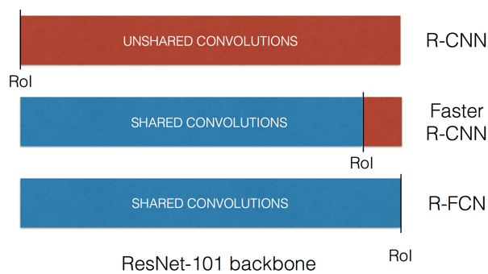
Methodology - RFCN
More Shared Convolution = Faster Inference Speed

Slide 11
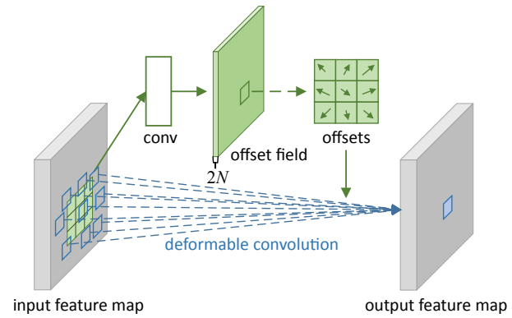
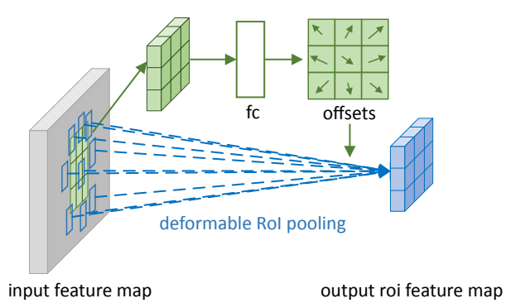
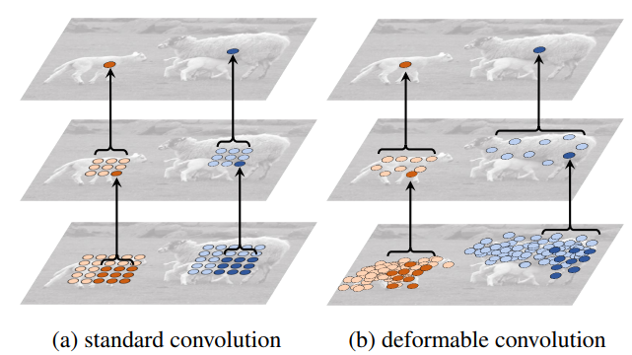
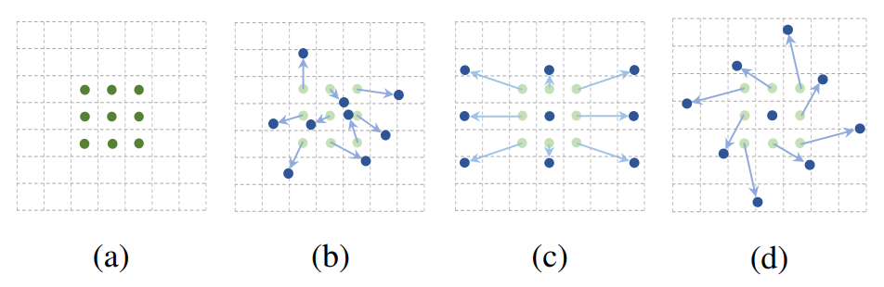
Methodology – Deformable Convolution

Slide 12
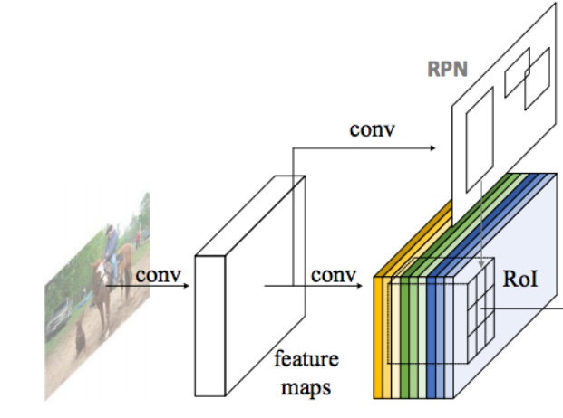
Methodology – RDFCN
deformable
deformable
Output layer
Resnet-101

Slide 13
Experiment 1 – train on 60k images
Method:
Train from scratch (Resnet-101 retrained)
Fine-tune the pre-trained model from UADETRAC
Fine-tune the output layer of model from UADETRAC
Fine-tune the pre-trained model from COCO
Fine-tune the output layer of model from COCO
deformable
deformable
Output layer
Resnet-101

Slide 14
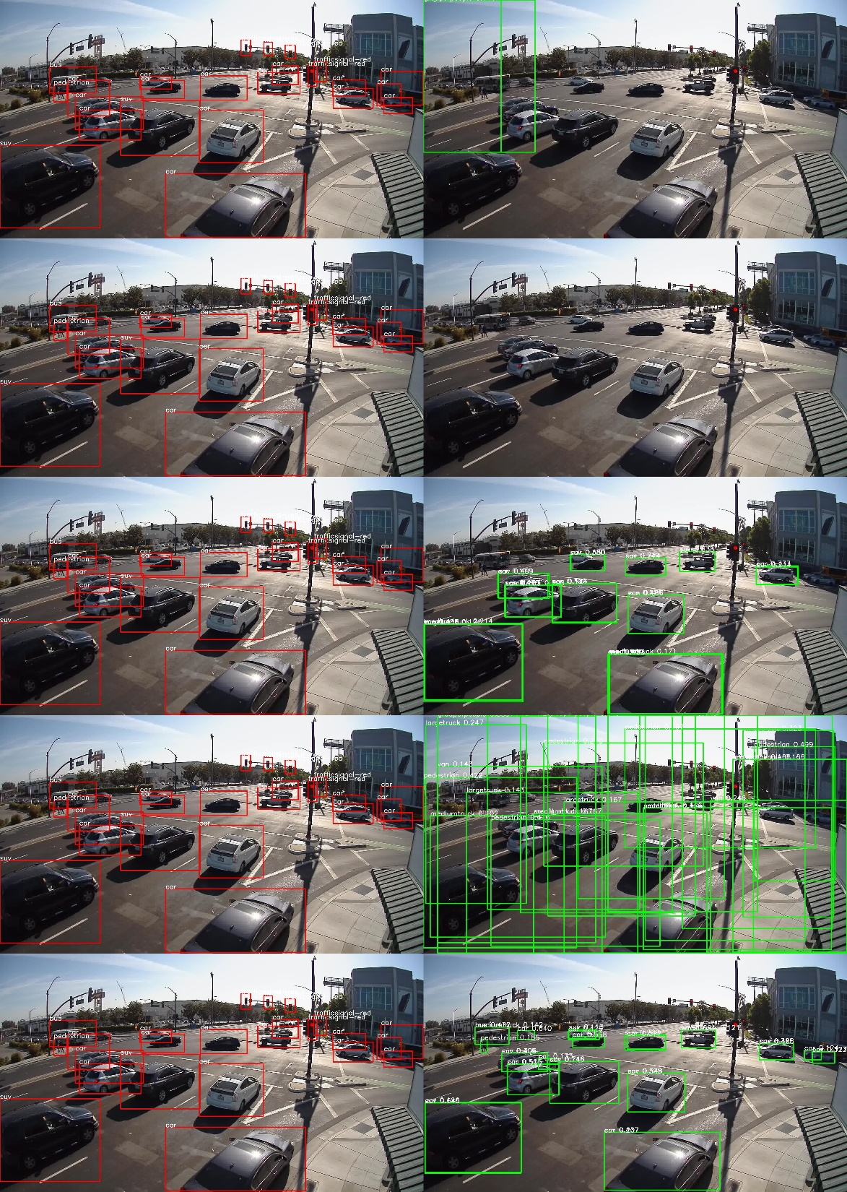
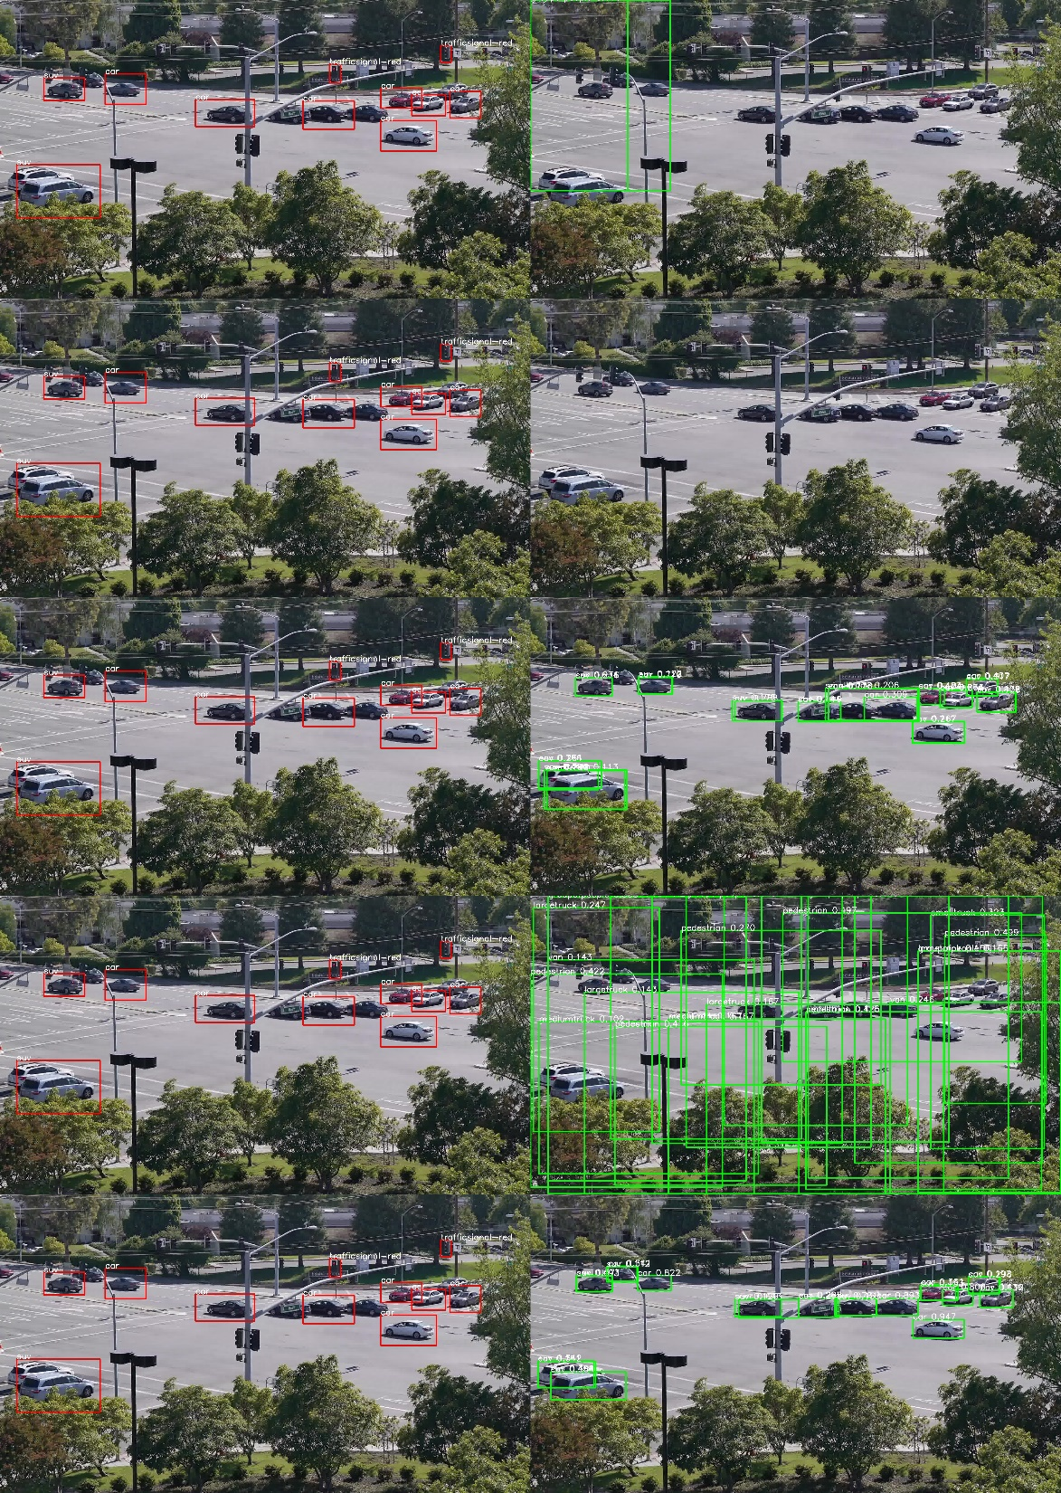
Experiment1 Results (confidence > 0.1)
Annotations
Detections
Annotations
Detections
Train from scratch
Fine-tune UADETRAC
Fine-tune UADETRAC output
Fine-tune COCO
Fine-tune COCO output

Slide 15
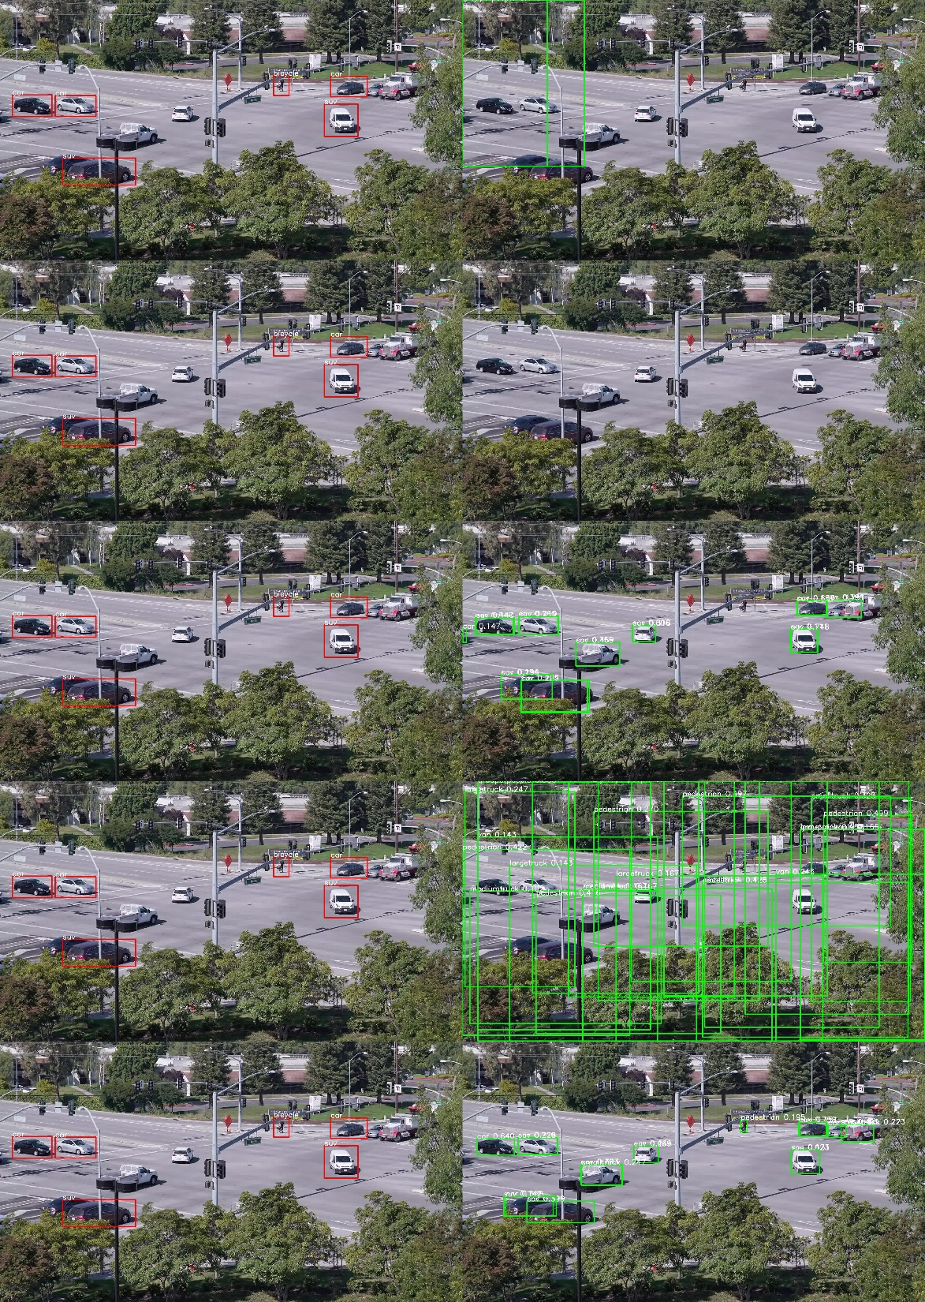
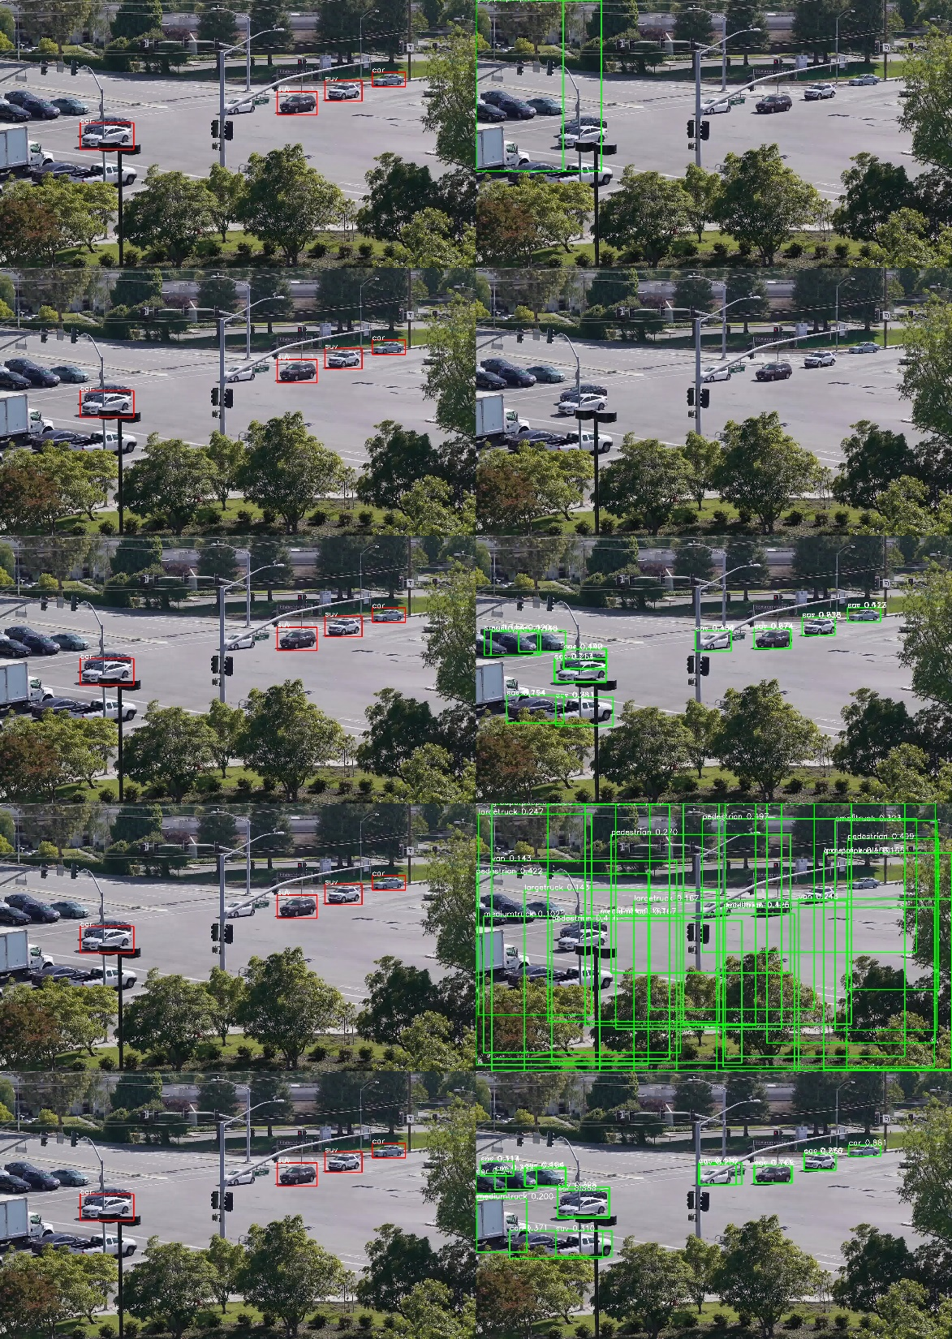
Experiment1 Results (confidence > 0.1)
Annotations
Detections
Annotations
Detections
Train from scratch
Fine-tune UADETRAC
Fine-tune UADETRAC output
Fine-tune COCO
Fine-tune COCO output

Slide 16
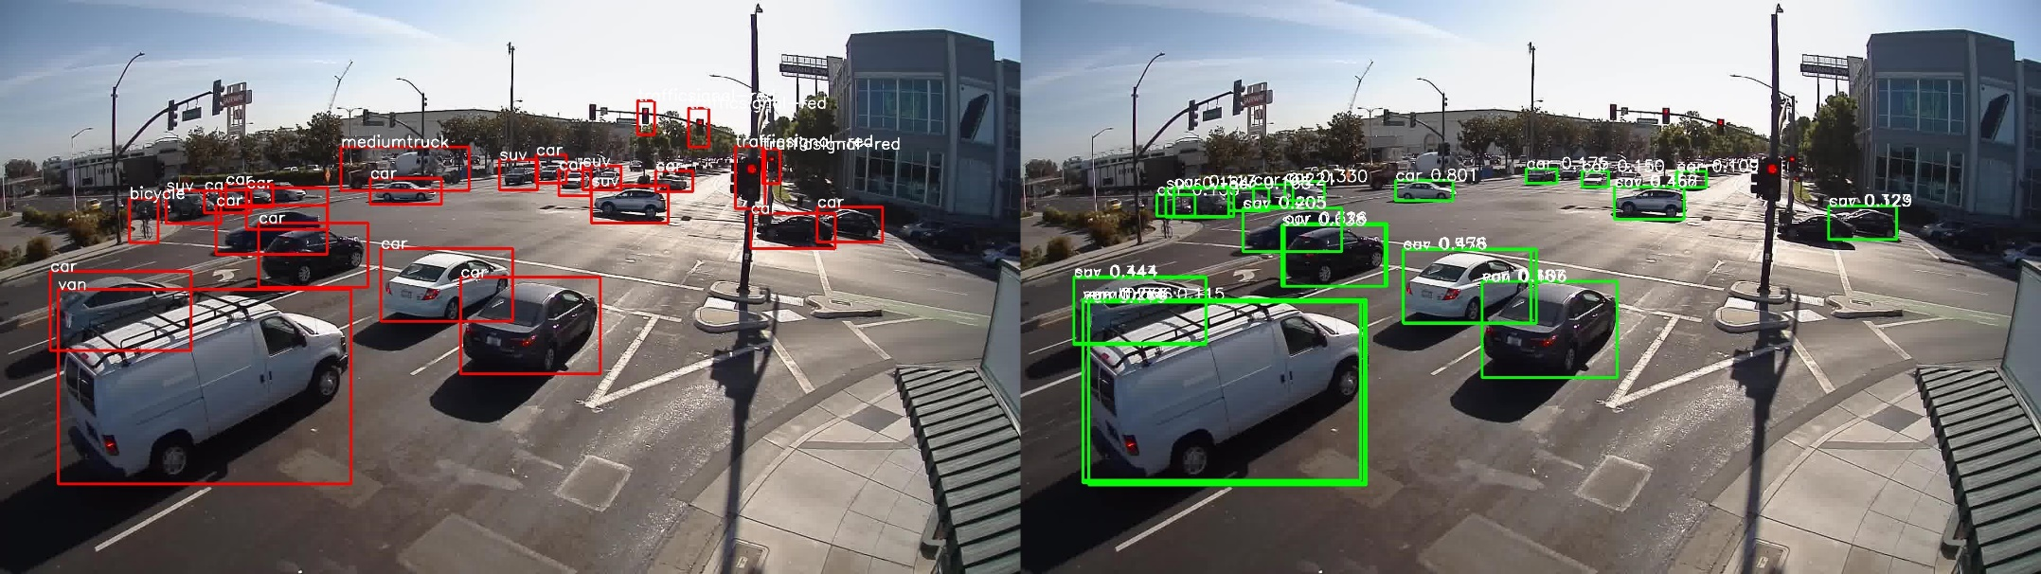
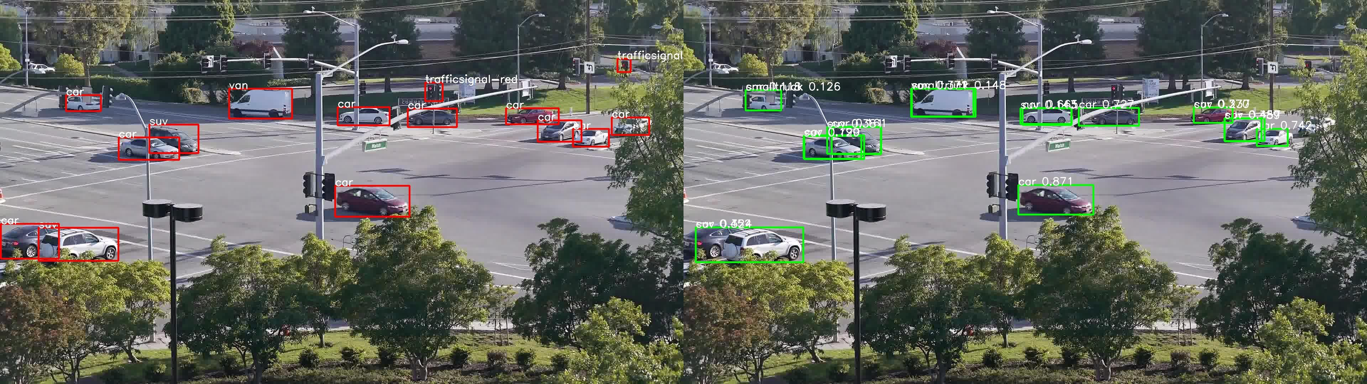
Training data check - good
Annotations as ground truth
Fine-tune COCO output

Slide 17
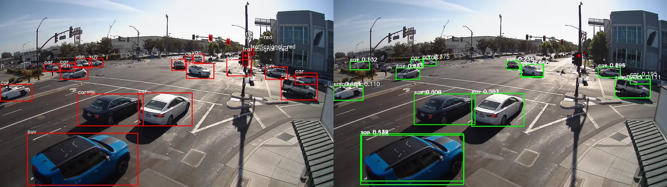
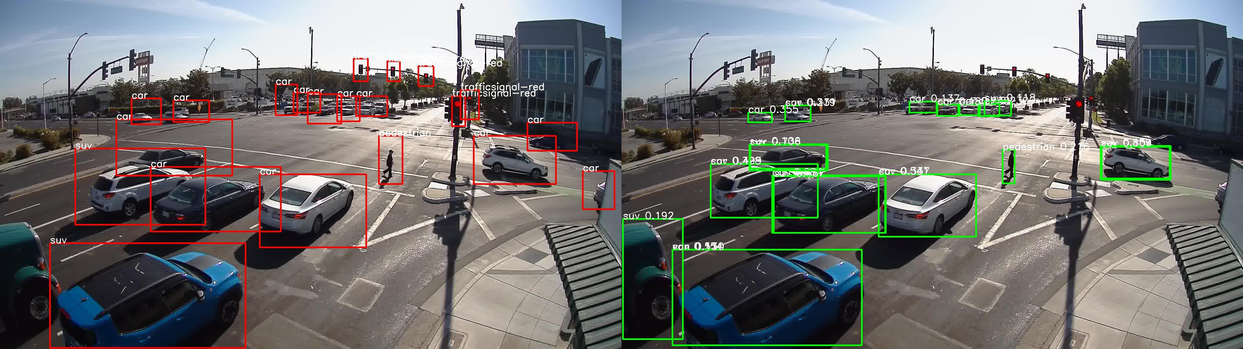
Training data check – not good
Annotations as ground truth
Fine-tune COCO output

Slide 18
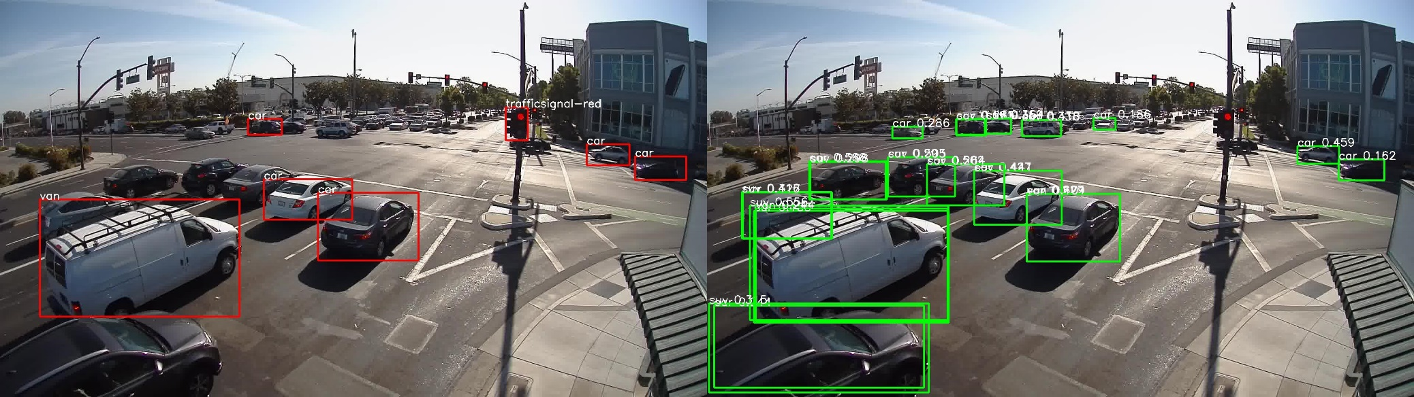
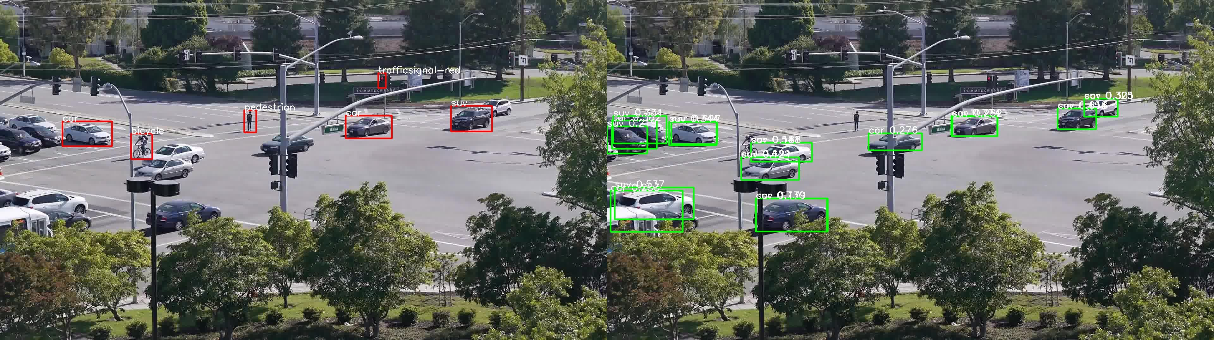
Training data check - bad
Annotations as ground truth
Fine-tune COCO output

Slide 19
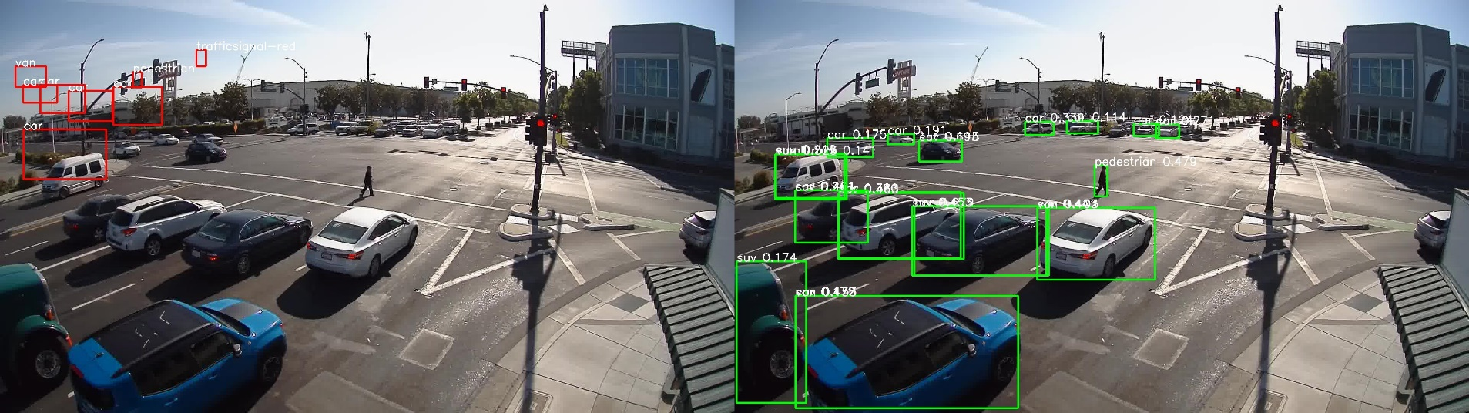
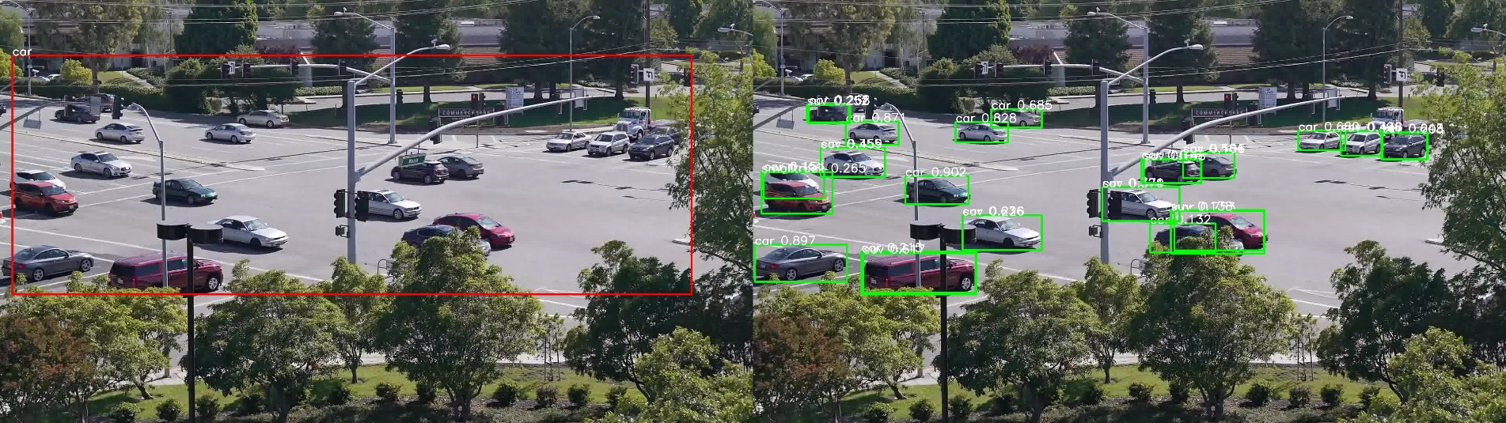
Training data check – very bad
Annotations as ground truth
Fine-tune COCO output

Slide 20
Experiment2 – train on 0.8k selected images
Data:
1000 good annotations manually selected from 5000 images
800 for training
200 reserved for testing
Method:
Train from scratch (Resnet-101 retrained)
Fine-tune the pre-trained model from UADETRAC
Fine-tune the output layer of model from UADETRAC
Fine-tune the pre-trained model from COCO
Fine-tune the output layer of model from COCO

Slide 21
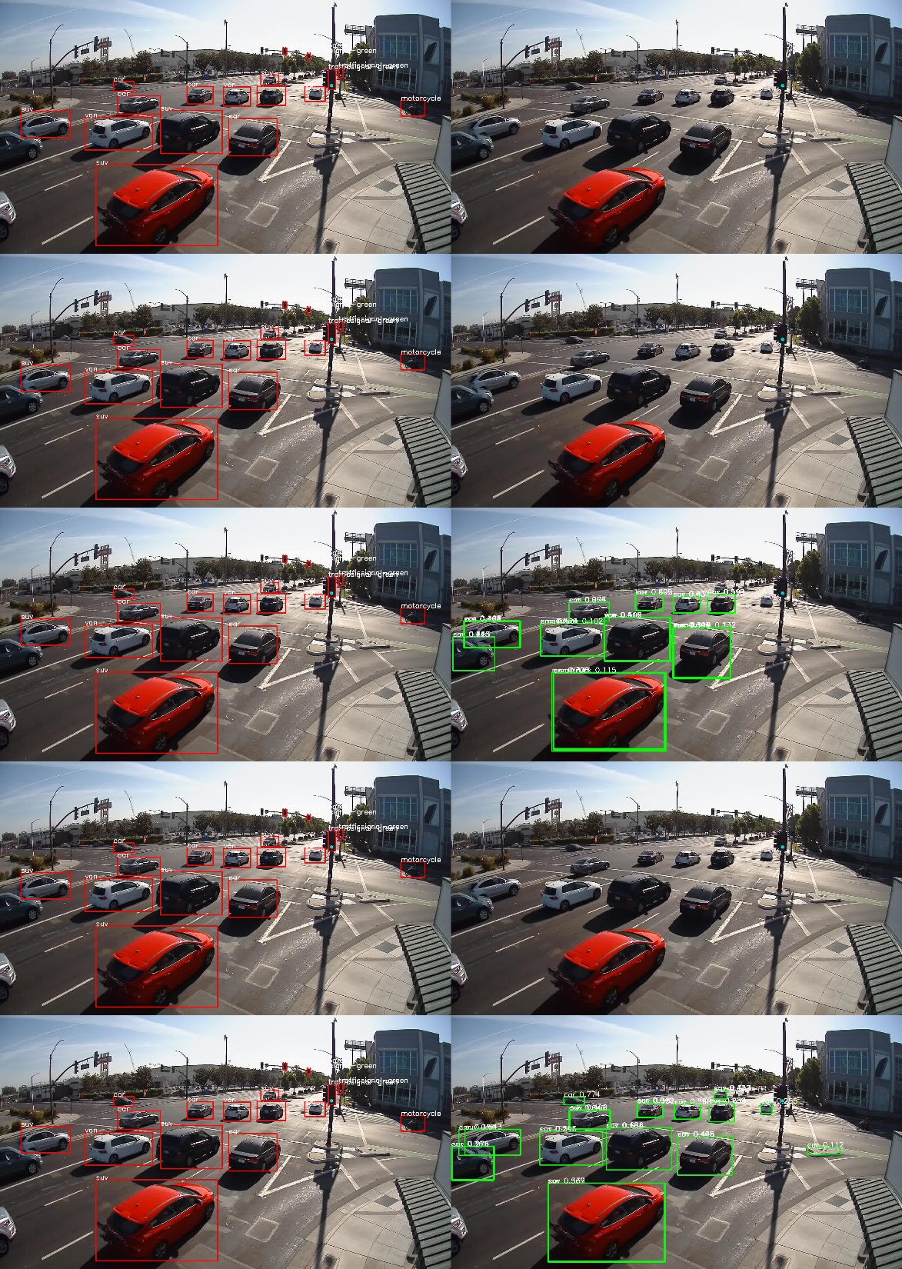
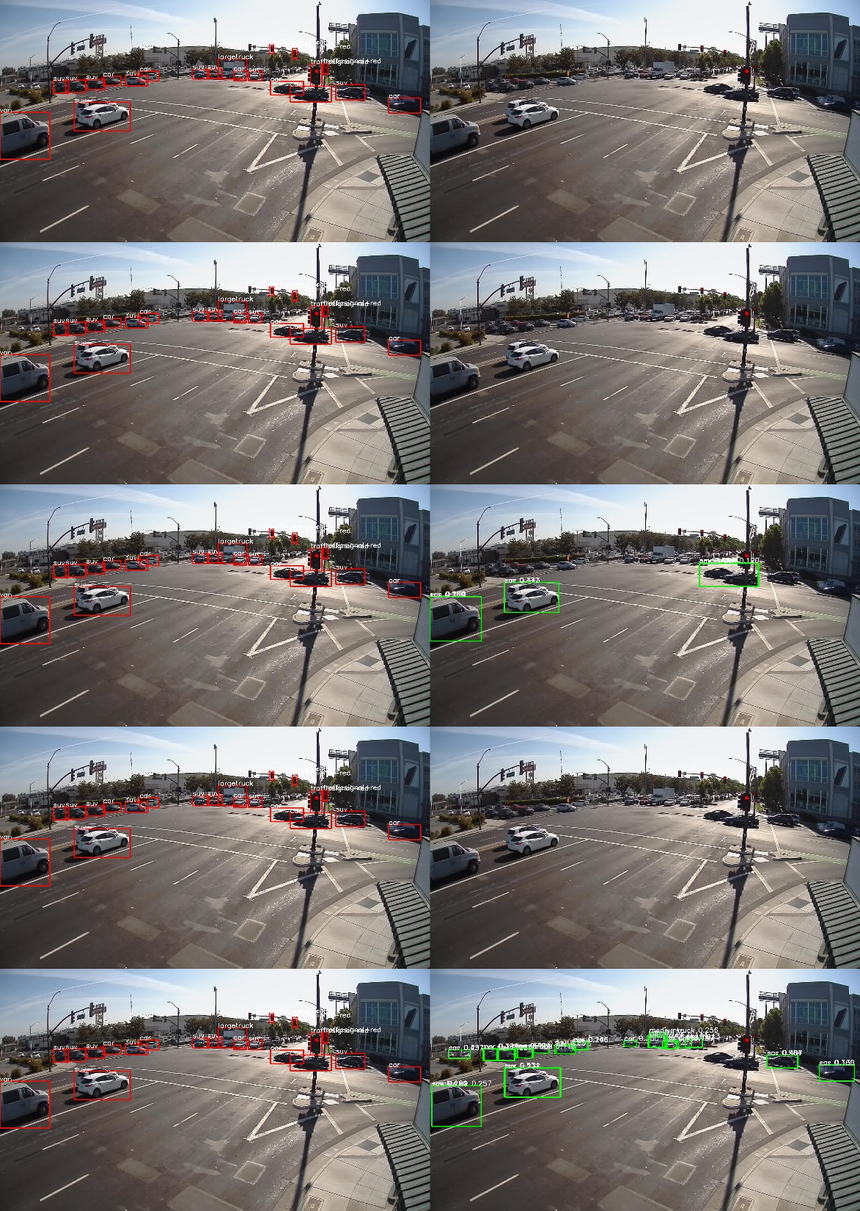
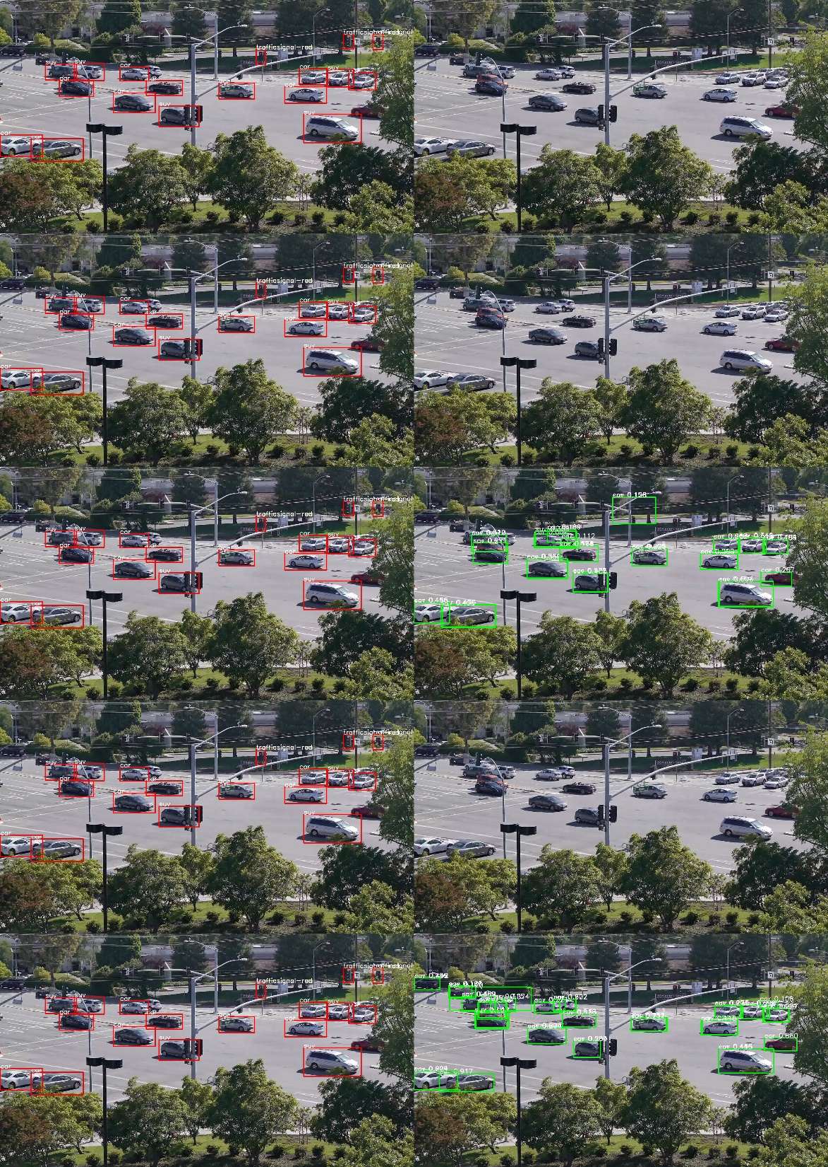
Experiment2 Results (confidence > 0.1)

Slide 22
Experiment 3 – Fine-tune model from COCO
Fine-tune Method:
1. Freeze Resnet-101, RPN and RFCN – 60k images
deformable
2. Freeze Resnet-101, RPN and RFCN – 0.8k images
deformable
Output layer
Resnet-101

Slide 23
Experiment 3 – Fine-tune model from COCO
Fine-tune Method:
1. Freeze Resnet-101, RPN and RFCN – 60k images
deformable
2. Freeze Resnet-101, RPN and RFCN – 0.8k images
3. Freeze Resnet-101 and RPN – 60k images
4. Freeze Resnet-101 and RPN – 0.8k images
deformable
Output layer
Resnet-101

Slide 24
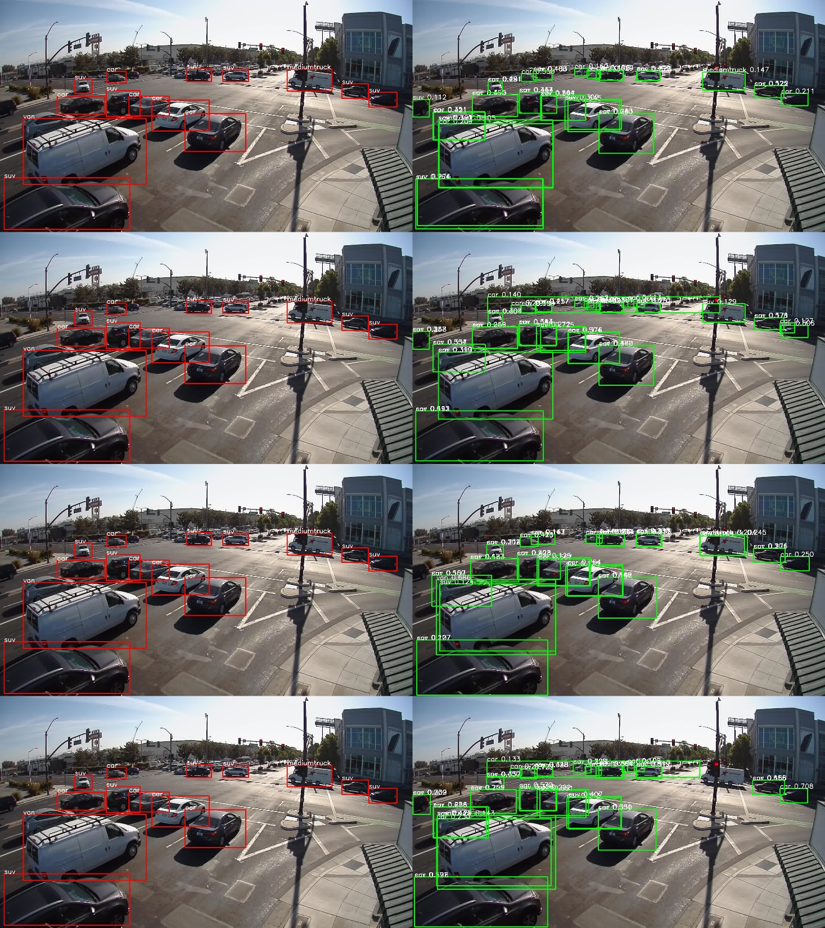
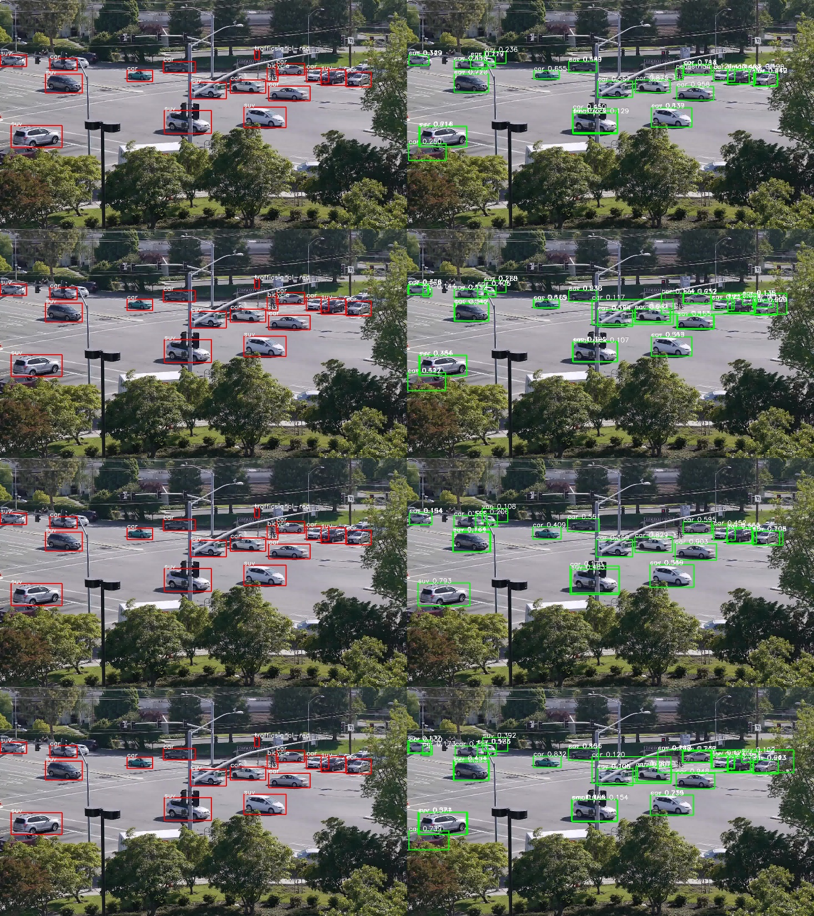
Experiment3 Results (confidence > 0.1)
Annotations
Detections
Annotations
Detections
Freeze All – 60k images
Freeze All – 0.8k images
Freeze RPN – 60k images
Freeze RPN – 0.8k images

Slide 25
Model Performances on the reserved 200 images
 | mAP
Freeze All – 60k images | 32.37%
Freeze All – 0.8k images | 26.09%
Freeze RPN – 60k images | 39.88%
Freeze RPN – 0.8k images | 34.54%

Slide 26
Model Fine Tune From COCO

Slide 27
Model Fine Tune From COCO

Slide 28
THANK YOU

